Slide 1
Gym workout calories burnt prediction (Web application )
Sahul hammed Mohammed Sajith
CL/BSCSD/24/64

Slide 2
Problem statement
Understanding the problem and developing system software to address the underlying issue are the major goals of a problem statement. With the gym's success and membership increasing, a critical issue—the lack of an automated system for tracking calories burned—has surfaced. A web-based calorie estimating system that is integrated with cardio and exercise equipment is necessary given the growing trend of using technology to monitor and track fitness goals. To achieve their fitness goals, many people use machines like treadmills, ellipticals, or stationary bikes, and they often rely on internet tools to track their progress
After exercise, people are less aware of how many calories they are taking in.
They are unable to keep tabs on and record data pertaining to calories.

Slide 3
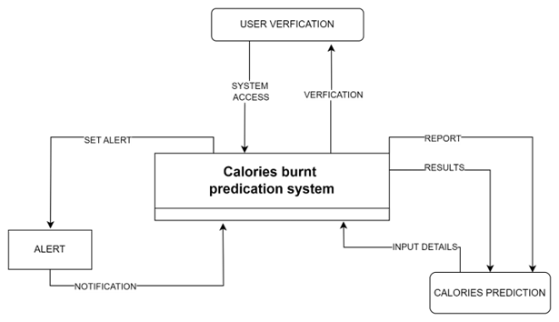
System Diagram

Slide 4
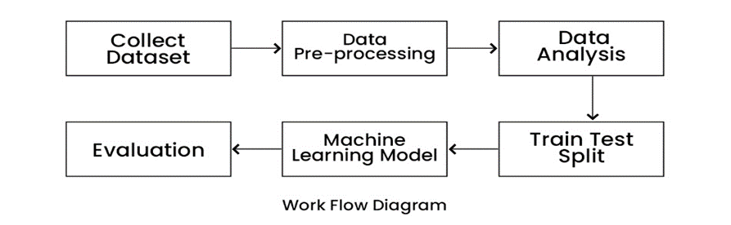

Slide 5
Literature review
Depended variable
Calories (3 article )
Independent variable
Gender
Age
Heart rate
Exercise type
Weight
Height ( 3 article )

Slide 6
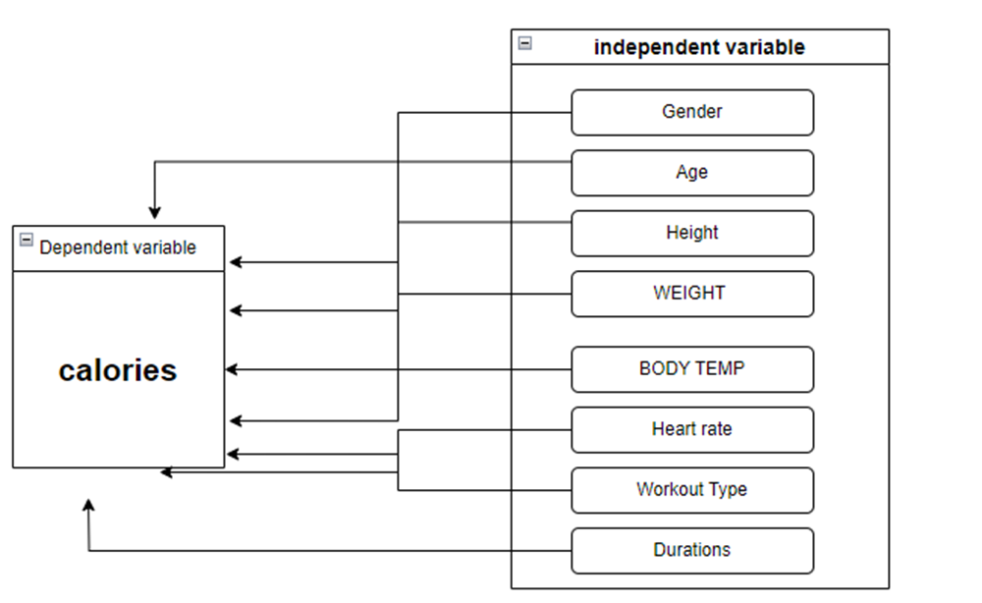
Conceptual diagram

Slide 7


Research analysis
Interviews
Survey analysis

Slide 8

Interviews
Personal Trainers
Healthcare Professionals
Tech-Savvy Users

Slide 9

Survey analysis (questionaries)
Name?
Age?
Gender?
What type of cardio workout do you typically engage in?
What motivates you to engage in cardio workouts?
Do you estimate the number of calories burned during your cardio workouts?

Slide 10
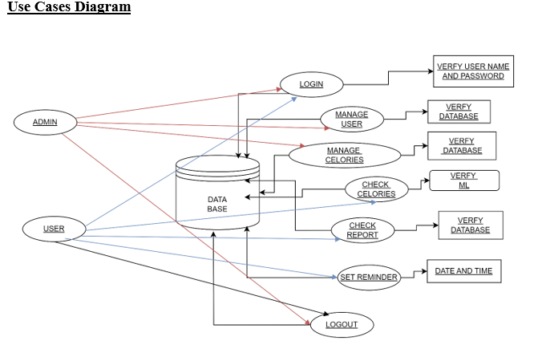
Design

Slide 11
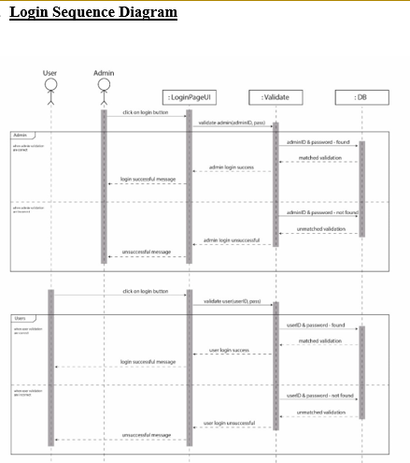

Slide 12
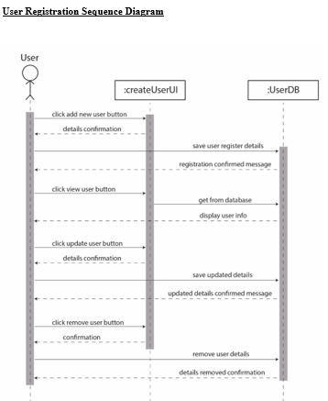

Slide 13
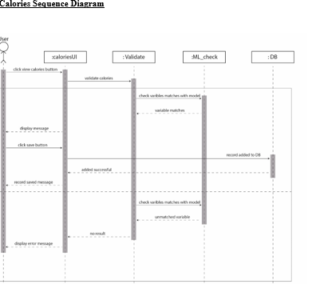

Slide 14
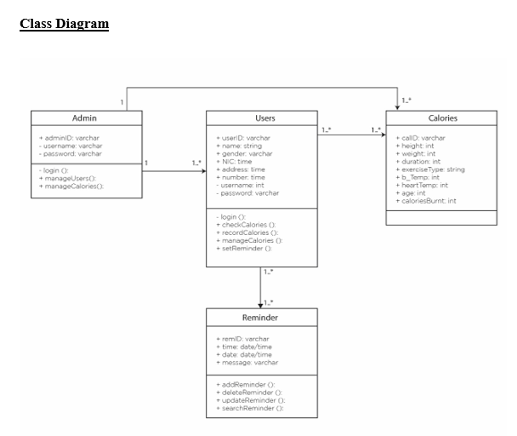

Slide 15
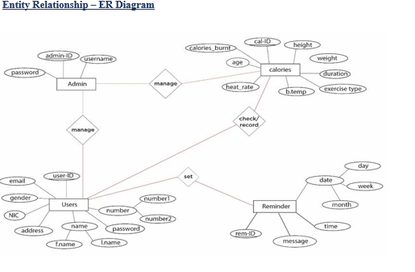

Slide 16
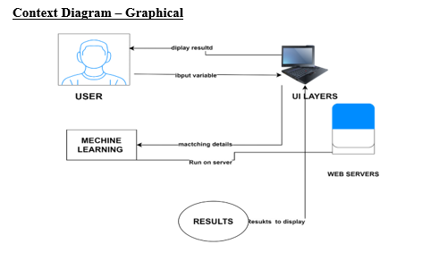

Slide 17
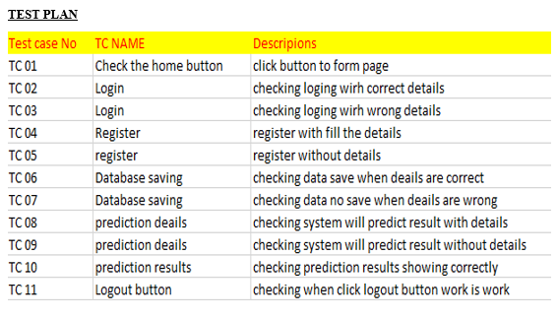
Test results

Slide 18
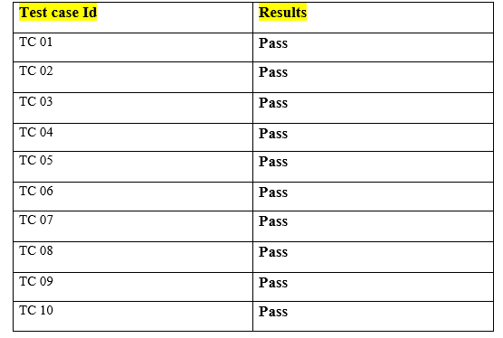
Results

Slide 19
Conclusion
The primary aim of this thesis is to empower users with an intuitive platform for precise calorie expenditure prediction. This involved using a unique machine learning technique to integrate calorie information into a website. Given the growing importance of calorie control for a healthy lifestyle, the project presented various challenges and exciting opportunities for improvement. Effective project management and user feedback played a pivotal role in enhancing the system. Collaboration with cutting-edge technologies was essential for success. This project not only improved technical skills but also honed project management abilities, which will be invluable in the future..

